Slide 1
From Ajax API to HTMX: Evolving Drupal Interactions
Ruturaj Chaubey – Full Stack Engineer @ QED42
Vighnesh Sadagopal – Full Stack Drupal Engineer @ QED42
Notes:
Open cold - screen already up for the live filter demo. No spoken line yet.

Slide 2
— LIVE
yoursite.example/articles
Filter by: Recipes ▾
mockup — live demo plays here in the browser
Notes:
Silent 15-20s clip: a filter on a Drupal listing page updates instantly as you type. No visible reload, no JS file open anywhere. Let it play, then pause on the result.

Slide 3
That's a live filter.
No JavaScript file.
No Ajax command class.
Just HTML.
Notes:
“That's a live filter. No JavaScript file. No Ajax command class. Just HTML.”

Slide 4
Who's talking
RC
Ruturaj Chaubey
Full Stack Engineer @ QED42
VS
Vighnesh Sadagopal
Full Stack Drupal Engineer @ QED42
Notes:
Ruturaj: Hi, I'm Ruturaj - Full Stack Engineer at QED42. Vighnesh: And I'm Vighnesh - Full Stack Drupal Engineer at QED42.

Slide 5
“The future of Drupal UX isn't more JS.
It's smarter HTML, with HTMX.”
Notes:
Land the quote with room to breathe.

Slide 6
Where we're headed
02
Why the Ajax API gets painful at scale
03
HTMX's core idea
04
Mapping that idea onto Drupal's render, routing & caching
05
Live: a form, a filter, a partial update — barely any JS
06
Ajax API vs HTMX, compared honestly
07
Bringing it into a project you already have
08
Where HTMX stands in Drupal core today, and how to contribute
Notes:
Over the next 35 minutes: why the Ajax API gets painful at scale, HTMX's core idea, and how that idea maps directly onto Drupal's render, routing and caching system. Then we watch it work live. After that, an honest comparison, how to bring this into a project you already have, and where HTMX stands in Drupal core today, plus how you can help.

Slide 7
Ajax API: Evolution & Pain Points
02
Notes:
Let's start with where we are today - the Ajax API.

Slide 8
Ajax API: Evolution & Pain Points
— A BRIEF HISTORY
DRUPAL 7
Ajax API unified into a single core framework
DRUPAL 8 → 11
Rebuilt on Symfony's HttpKernel, AjaxResponse extends JsonResponse; interactions become a stack of Commands
Mature. Well-documented. Everywhere in core: exposed filters, autocomplete, modals, inline entity forms.
The right answer for 2011.
Notes:
Drupal's Ajax API isn't new - it's been part of core in its current form since Drupal 7, unified under a single framework. In Drupal 8 through 11, it was rebuilt on top of Symfony's HttpKernel - AjaxResponse extends Symfony's JsonResponse, and interactions are expressed as a stack of Command objects. It's mature, well-documented, and used everywhere in core - exposed filters, autocomplete, modal dialogs, inline entity forms. This isn't a story about a broken system. It's a story about a system that was the right answer for 2011, and is starting to show its age.

Slide 9
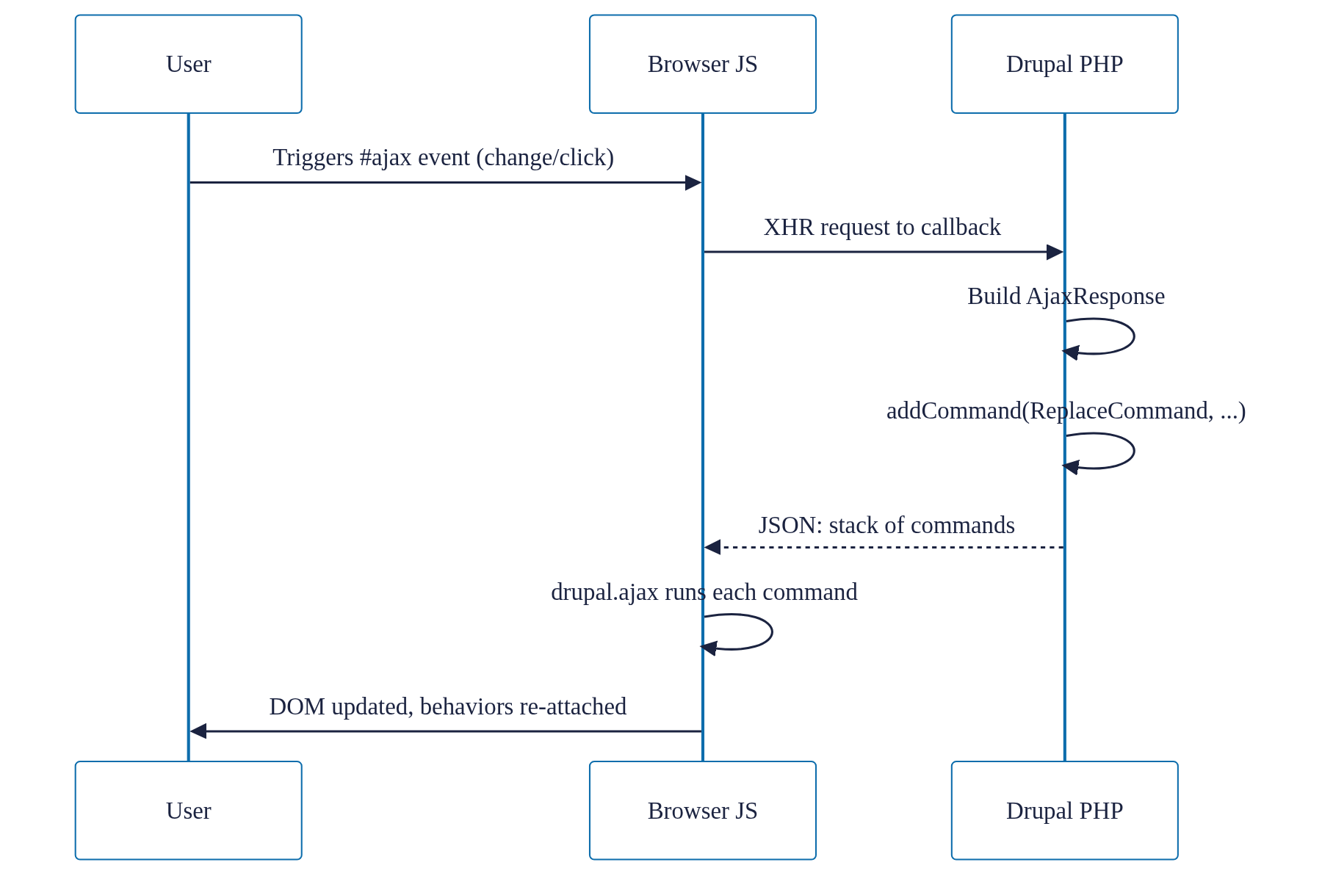
Ajax API request/response cycle
— THE REQUEST/RESPONSE CYCLE
Notes:
Walk through the diagram: user triggers the #ajax event, browser sends an XHR to the callback, server builds an AjaxResponse with commands, drupal.ajax runs each command, the DOM updates and behaviors re-attach.

Slide 10
The #ajax property
— IN CODE
$form['filter'] = [
'#type' => 'select',
'#ajax' => [
'callback' => '::updateResults',
'wrapper' => 'results-wrapper',
'event' => 'change',
],
];
public function updateResults(...) {
$response = new AjaxResponse();
$response->addCommand(new ReplaceCommand(
'#results-wrapper', $form['results']));
return $response;
}
Two files. Two languages. One wrapper ID that has to match exactly or nothing happens. Silently.
Notes:
Two files, two languages, and a wrapper ID string that has to match exactly in both places, or nothing happens - silently.

Slide 11
Four pain points
JS COUPLING
Custom interactions need a PHP command plus a matching JS command handler.
COMPLEXITY
An imperative command stack, not a description of the result.
MAINTENANCE OVERHEAD
One typo, no error, silent failure.
DISCOVERABILITY
The markup never says it's interactive.
Notes:
Four pain points: JS coupling, complexity, maintenance overhead, discoverability.

Slide 12
— A TRUE STORY
“40 minutes in devtools. The bug wasn't PHP. It wasn't JS logic. It was one mismatched wrapper ID, three directories away. Nothing threw an error. It just didn't work.”
Notes:
I once spent 40 minutes in devtools debugging an Ajax response that updated one region but silently failed on another. The bug wasn't in the PHP, and it wasn't in the JS logic - it was a mismatched wrapper ID, one string, defined in a template three directories away from the PHP that built the response. Nothing threw an error. It just... didn't work. Same wrapper ID you just saw in the code - that one string is the whole bug.

Slide 13
…the element itself could just describe what it needs?
— SO WHAT IF…
No command classes. No wrapper-ID matching. No second file to go find.
→ next: HTMX
Notes:
So what if, instead of a callback, a command class and a wrapper ID to keep in sync for every interaction, the element itself could just describe what it needs - when this changes, fetch this URL, and drop the result here? No command classes, no wrapper-ID matching, no second file to go find. What would that even look like? (pause, slide transition - next section opens with the reveal: That's not a hypothetical. It's called HTMX...)

Slide 14
That's not a hypothetical.
It's called HTMX.
Built on an idea older than Ajax: hypermedia.
Notes:
That's not a hypothetical. It's called HTMX - and it's built on an idea that's actually older than Ajax: hypermedia.

Slide 15
HTMX & Hypermedia Principles
03
Notes:
(Let the section number land.) So what is hypermedia, and why does it matter for Drupal? Let's unpack it.

Slide 16
— THE IDEA
You already know hypermedia. Every <a href> and every <form> you've ever written is a hypermedia control, an element that tells the browser what to fetch and where to put the result. HTMX just extends that vocabulary: any element, any event, any HTTP verb, any part of the page as the target.
Notes:
You already know hypermedia. Every <a href> and every <form> you've ever written is a hypermedia control - an element that tells the browser what to fetch and where to put the result. HTMX just extends that vocabulary: any element, any event, any HTTP verb, any part of the page as the target.

Slide 17
One element. Four attributes.
— IN CODE
<select hx-get="/filter-results"
hx-trigger="change"
hx-target="#results"
hx-swap="innerHTML">
...
</select>
<div id="results">
<!-- server returns just this fragment -->
</div>
One element. Four attributes. The behavior lives right there in the tag — no PHP file to go find, no wrapper ID to keep in sync across two files.
Notes:
One element. Four attributes. The behavior lives right there in the tag - no PHP file to go find, no wrapper ID to keep in sync across two files. The four core attributes: verb (hx-get/post/put/delete), trigger (any DOM event), target (any element), swap (innerHTML, outerHTML, beforeend, afterbegin, and more).

Slide 18
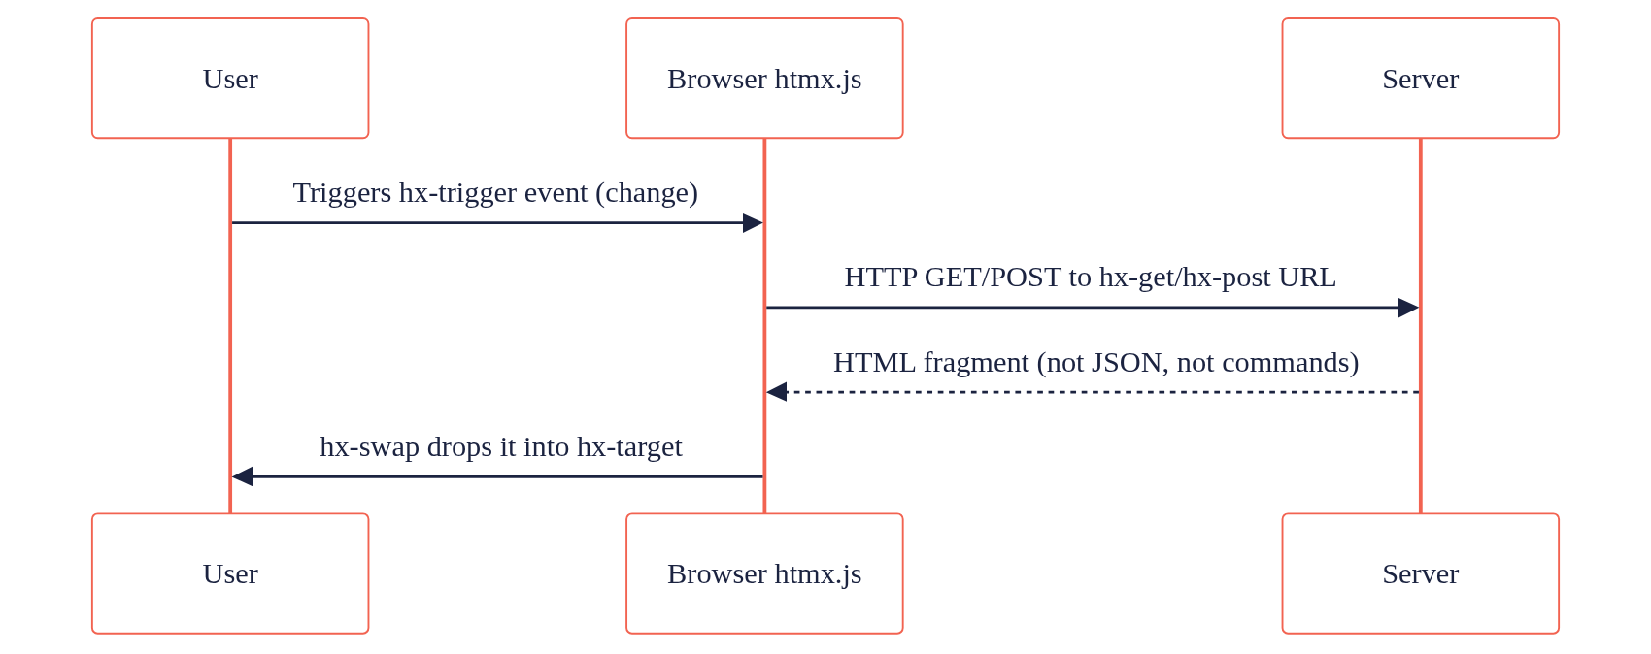
HTMX request/response cycle
— THE REQUEST/RESPONSE CYCLE
Same three participants: user, browser, server. Seven steps in the Ajax version. Four here.
Notes:
Compare that to the version you saw ten minutes ago: same three participants - user, browser, server - but four steps instead of seven.

Slide 19
The response is the next state of the UI — already rendered.
— THE BIGGER IDEA
No separate JSON API.
No client-side templating layer.
HTMX just closes the gap between the first page load and everything after, so both work the same way.
Notes:
There's no separate JSON API here, no client-side templating layer reconstructing HTML from data. The server decides what HTML comes back - same as it always has for the initial page load. HTMX isn't a new architecture. It's closing the gap between 'first page load' and 'everything after,' so both work the same way. That's what 'hypermedia-driven' means - the response is the next state of the UI, already rendered. So HTMX gives Drupal back a vocabulary it never actually lost - hypermedia. Next: how that maps onto Drupal's own architecture.

Slide 20
Mapping HTMX onto Drupal's Architecture
04
Notes:
HTMX doesn't need anything special from Drupal. It needs three things Drupal already has, and has had for over a decade: routes, render arrays, and cache metadata. Let's map them one at a time.

Slide 21
A normal Drupal route
— ROUTING
my_module.filter_results:
path: '/filter-results'
defaults:
_controller: '\Drupal\my_module\Controller\FilterController::results'
requirements:
_access: 'TRUE'
options:
_htmx_route: TRUE
hx-get="/filter-results" isn't a special Ajax callback. It's a normal Drupal route with one flag: _htmx_route returns just the main content and its assets, not the whole themed page.
Notes:
An hx-get URL isn't a special Ajax callback - it's a normal Drupal route with one flag. _htmx_route: TRUE tells Drupal to return just the main content and its assets. Without it, you'd get the whole themed page back. No #ajax property, no form-building context required.

Slide 22
The same render array Drupal always returns
— RENDER ARRAYS
public function results(Request $request) {
$filter = $request->query->get('filter');
return [
'#theme' => 'item_list',
'#items' => $this->getFilteredItems($filter),
'#cache' => [
'tags' => ['node_list'],
'contexts' => ['url.query_args:filter'],
],
];
}
The same render array every Drupal controller already returns. No AjaxResponse. No Commands. The render pipeline already builds exactly this.
Notes:
The controller returns a render array - the same thing every Drupal controller has always returned. Drupal renders it to HTML. HTMX drops that HTML wherever hx-target points. No AjaxResponse, no Commands - the render pipeline was already built to produce exactly this.

Slide 23
Core does the glue
— CORE'S HTMX CLASS
use Drupal\Core\Htmx\Htmx;
(new Htmx())
->get(Url::fromRoute('my_module.filter_results'))
->trigger('change')
->target('#results')
->swap('innerHTML')
->applyTo($form['filter']);
The same four hx-* attributes, built in PHP. applyTo() attaches core/drupal.htmx, which loads the response's assets and re-attaches Drupal.behaviors after every swap.
Notes:
And on the markup side, since 11.3 you don't have to hand-write hx attributes. Core's Htmx class builds every htmx attribute from PHP - the same four from the cheat sheet - and applies them to a render element. applyTo() also attaches core/drupal.htmx, which loads any CSS and JS the response needs and re-attaches Drupal.behaviors after every swap.

Slide 24
— WHERE THIS PAYS OFF
AJAX API
An AjaxResponse built from Commands doesn't sit in the cache pipeline. You're mostly on your own.
HTMX
A plain render array — cache tags bubble up, contexts vary the response automatically. Caching for free.
Notes:
Here's the part that doesn't exist for the Ajax API without extra work: because this is a plain render array, it gets Drupal's caching for free. Cache tags bubble up automatically, cache contexts vary the response correctly. An AjaxResponse built from Commands doesn't sit in that pipeline the same way - you're mostly on your own for caching an Ajax callback response. So: a URL is a route, the HTML is a render array, and caching is #cache tags and contexts - three things Drupal already gives every page. Let's see it work.

Slide 25
Live Demo
PLACEHOLDER — dynamic form, filter & partial update, one combined demo built/walked through live in the browser.
05
Notes:
[Budget: 8 min - keep it to one combined flow.] [Live demo - build/walk through here] One combined demo covering the dynamic form, filter, and partial update in a single flow, per the session-flow design note.

Slide 26
Ajax API vs HTMX, Compared Honestly
06
Notes:
HTMX doesn't win everywhere. Let's put the two side by side across five axes, honestly.

Slide 27
The verdict, side by side
 | Ajax API | HTMX
DX | More ceremony, most proven for complex multi-step forms | Less ceremony, multi-step patterns still maturing
Performance | JSON command stack, executed client-side | Small library, HTML response, up to 71% less JS
Debugging | Opaque command stack, silent failures | Transparent — see the actual HTML
Caching | AjaxResponse sits outside the render cache — mostly on your own | Plain render array — cache tags & contexts bubble automatically
Learning curve | Drupal-only API | Standard htmx — htmx.org docs, a skill that transfers beyond Drupal
Notes:
DX: the Ajax API is more ceremony, but it's the most proven path for complex multi-step forms and wizards. HTMX is far less ceremony, and since 11.3 Form API can rebuild forms from HTMX requests - but complex multi-step flows are less proven. Performance: an Ajax response is a JSON command stack that core/drupal.ajax runs command by command. HTMX is a ~16kb library and the response is the HTML itself. Drupal.org reports up to 71% less JavaScript loaded for browser-server interactions with native HTMX in 11.3. Debugging: in the Ajax API, the Network tab shows an opaque command stack, and a wrapper-ID typo fails silently. With HTMX, the Network tab shows the literal HTML that got inserted. Caching: an AjaxResponse sits outside the render cache, so you're mostly on your own - HTMX responses are plain render arrays, so cache tags and contexts bubble up automatically, as we saw in the mapping section. Learning curve: the Ajax API is a Drupal-only API; HTMX is standard htmx, documented at htmx.org, so what you learn transfers to any backend. Five axes, side by side. It isn't a clean sweep - the Ajax API still has the edge on complex multi-step forms.

Slide 28
Pick the tool for the job, not the trend.
HTMX: where round trips are simple and the UI is a fragment.
Ajax API: where it already works, and for complex multi-step flows, for now. This isn't a replace-everything story.
Notes:
Pick HTMX where round trips are simple and the UI is a fragment. Keep the Ajax API where it already works, and for complex multi-step flows until HTMX patterns there mature. This isn't a replace-everything story. It's a which-tool-for-which-job story. Next: how to actually bring HTMX into a project you already have, without a rewrite.

Slide 29
Incremental Adoption Strategy
07
Notes:
Let's talk about incremental adoption: how to bring HTMX into a project you already have, without a rewrite.

Slide 30
Adopt it in three steps
— NO REWRITE REQUIRED
1
CHECK
On Drupal 11.3+, HTMX is already in core. Nothing to install.
2
PICK ONE SPOT
Something small: a filter, a dependent dropdown, a load-more.
3
CONVERT IT
Swap one #ajax callback for HTMX. Leave everything else alone.
HTMX and #ajax work side by side on the same page, so you can stop after any step.
Notes:
Let's make adoption concrete. You don't need a migration plan - you need one small spot and an afternoon. Three steps. One, check: on Drupal 11.3 and up, HTMX is already in core. Nothing to install, no library, no build step. Two, pick one spot: something small and self-contained, like a filter, a dependent dropdown or a load-more button. Three, convert it: swap that one #ajax callback for HTMX, and leave everything else alone. HTMX and #ajax run side by side on the same page, so you can stop after any step and nothing breaks. It's like renovating a house while you live in it: one room at a time.

Slide 31
Convert one #ajax callback
— STEP 3, IN CODE
BEFORE · AJAX API
AFTER · HTMX
$form['filter']['#ajax'] = [
'callback' => '::updateResults',
'wrapper' => 'results-wrapper',
];
// + updateResults() builds an
// AjaxResponse + ReplaceCommand
(new Htmx())
->get(Url::fromRoute('my_module.filter_results'))
->trigger('change')
->target('#results')
->applyTo($form['filter']);
// + route with _htmx_route: TRUE
// controller returns a render array
Same feature. No command class, no wrapper ID to keep in sync, and the response is cacheable.
Notes:
Here's step three, using the filter we've followed all talk. On the left, today's Ajax API version: an #ajax array with a callback and a wrapper ID, plus a callback method that builds an AjaxResponse with a ReplaceCommand. On the right, the HTMX version: the Htmx class says get this route, on change, and put the result in #results. Behind it, a normal route with _htmx_route, and a controller that returns a render array. That's the whole migration for one interaction. No command class, no wrapper ID to keep in sync, and because it's a render array, the response is cacheable. Everything on the right, you already saw in the mapping section. And once that works, the rule of thumb: new interactive features, HTMX by default. Existing Ajax code that works, leave it alone. Complex multi-step forms and wizards, keep them on the Ajax API for now. It's a second tool in the same box, not a rewrite.

Slide 32
Current Status + How to Contribute
08
Notes:
So, where are we today?

Slide 33
— WHERE THINGS STAND TODAY
This isn't a someday story - HTMX arrived in core in 11.2 and became fully featured in 11.3, as part of an active initiative to replace the Ajax system.
CORE INITIATIVE
"Replace AJAX API with HTMX" - an official community initiative, still active. Both APIs run side by side until contrib has time to convert.
CONTRIB MODULE
drupal/htmx adds extra tooling on top of core - 1,156 sites already using it.
Up to 71% less JavaScript loaded for browser-server interactions with native HTMX, per drupal.org.
Notes:
This isn't a someday story. HTMX came into core as a dependency in 11.2 and became fully featured in 11.3, as part of an active community initiative, Replace AJAX API with HTMX. Both APIs are running side by side right now, on purpose, while contrib gets time to convert. And the payoff is measurable: drupal.org reports up to 71% less JavaScript loaded for browser-server interactions.

Slide 34
How to contribute
CORE INITIATIVE
drupal.org/community-initiatives/replace-ajax-api-with-htmx - plus the plan issue #3404409 and its child issues.
CONTRIB MODULE
drupal.org/project/htmx issue queue.
COMMUNITY
#htmx on Drupal Slack. Coordination meetings every other Thursday, open for 24 hours.
ENTRY POINTS
Triage issues, convert one #ajax callback, write docs, build a case study.
Notes:
Start at the initiative page on drupal.org: Replace AJAX API with HTMX. From there, the plan issue and its child issues are where core work happens. The contrib module has its own issue queue, and the #htmx channel on Drupal Slack is where the lead collaborators talk almost daily, with coordination meetings every other Thursday, left open for 24 hours so every time zone can join. Entry points: triage issues, convert a #ajax/Command usage to HTMX and report back, write docs/examples, build real-world case studies like this talk. And this isn't waiting on permission - if you're on 11.3, it's already on your site. Go convert one #ajax callback and see how it feels.

Slide 35
Four things to take home
THE PROBLEM
Ajax API: callback, command stack and wrapper ID kept in sync, failing silently.
THE IDEA
HTMX puts the behavior in the markup. The server just returns HTML.
THE FIT
Routes, render arrays, cache metadata: Drupal already has all three.
THE PATH
New features in HTMX. Leave working Ajax alone. Convert one callback.
Notes:
Four things to take home. The problem: the Ajax API makes you keep a callback, a command stack and a wrapper ID in sync, and when they drift it fails silently. The idea: HTMX puts the behavior right in the markup, and the server just returns HTML. The fit: HTMX only needs routes, render arrays and cache metadata - Drupal has had all three for over a decade, and since 11.3 core ships an Htmx class to glue them together. The path: build new interactive features with HTMX, leave working Ajax code alone, and go convert one callback to see how it feels. That's it from us.

Slide 36
Thank you!
Questions?
Ruturaj Chaubey – Full Stack Engineer @ QED42
Vighnesh Sadagopal – Full Stack Drupal Engineer @ QED42
Notes:
Thank everyone for coming, then open the floor for questions. Backup answers for likely questions are in docs/8-qa-backup.md.

